Slide 1


Heuristic Urban Traffic Flow Optimization
A Rule-Based Approach for Dynamic Traffic Signal Control
Presented By:
V.G Shanmukhasai (2520030341)
U.Pranav Varma (2520030351)
Dept: CSE
Guide: Dr. G. Sudhakar
Dept. of Computer Science & Engineering
KL University | Academic Year: 2025–2026

Slide 2

Presentation Agenda
This presentation covers the full lifecycle of the project — from problem motivation to hardware, software, and a detailed study of existing traffic systems.
01
02
03
Title & Team Details
Abstract & Proposal
Hardware & Software Requirements
Project overview, team composition, and institutional details
Problem background, core challenges, and proposed heuristic approach
Physical components and development tools used in the project
04
05
Methodology
References
Study of SCOOT, SCATS, gap analysis, and proposed system design
Academic citations and supporting literature

Slide 3


Abstract — The Problem & Our Approach
Core Challenges
Proposed Solution
Fixed-cycle signals cause unnecessary waiting even on empty roads
No real-time feedback or adaptive intelligence in conventional systems
ML systems demand large datasets and expensive GPU hardware
Emergency vehicles face delayed routing due to static signal logic
Peak-hour bottlenecks remain unresolved by rigid schedules
Excessive idling raises fuel consumption and emissions
This project proposes a Heuristic Rule-Based Traffic Signal Optimization System — using lightweight conditional logic to dynamically control signals in real time. Live vehicle density from sensors feeds predefined if-then rules to determine optimal green phase durations. No training data or complex models required.
Target: ↓30% wait time | ↓25% congestion | ↑40% throughput

Slide 4

Hardware Requirements
The prototype uses an embedded hardware stack combining a Raspberry Pi controller, Arduino signal driver, multiple sensor types, and a real-time web dashboard module — all designed for low-cost, field-deployable operation.
Raspberry Pi 4B
Arduino Mega 2560
Main processing unit running Python heuristic control logic with real-time sensor input and signal output handling.
Embedded controller for signal switching; runs C++ firmware for relay and LED control, communicating via serial/USB.
IR & Ultrasonic Sensors
ESP8266 Wi-Fi Module
HC-SR501/TCRT5000 detect vehicle presence; HC-SR04 measures queue length via distance estimation at each approach.
Transmits live sensor and phase data to a Flask web dashboard, enabling remote monitoring over local Wi-Fi.
LED Signal Modules + Relay
16×2 LCD with I2C
12V R/Y/G LED arrays per lane direction, switched by a 4-channel relay module controlled via Arduino GPIO pins.
Displays active phase, lane ID, and countdown timer — providing real-time status readout at the intersection.

Slide 5
Software Requirements
The software stack spans embedded firmware, simulation, data processing, and IoT communication — enabling full end-to-end development from algorithm testing to physical deployment.
Languages & Frameworks
Simulation & IoT
Python 3.x — Heuristic logic, sensor interfacing, Flask dashboard
C++ (Arduino IDE) — Embedded relay and signal firmware
HTML/CSS/JavaScript — Web dashboard front-end
SUMO — Open-source urban mobility simulator for pre-deployment algorithm testing
TraCI API — Python interface for real-time SUMO control
MQTT (Mosquitto) — Lightweight pub/sub sensor-to-controller messaging
Key Python Libraries
Development Tools
NumPy / Pandas — Sensor data processing and traffic log analysis
Matplotlib — Performance charts and flow visualization
Flask / PySerial / RPi.GPIO — Dashboard, Arduino comms, GPIO control
VS Code / PyCharm — Python IDE
Git + GitHub — Version control
SQLite + CSV — Local logging and post-analysis
Draw.io — Architecture diagrams

Slide 6

Methodology Overview
The project methodology follows a structured three-stage pipeline — beginning with a deep study of established real-world systems, identifying their gaps, and using those insights to drive the design of the proposed heuristic controller.
Study SCOOT & SCATS
Design & Validate
Gap Analysis
This evidence-driven approach ensures that every design decision in the proposed system is motivated by a documented gap in existing state-of-the-art solutions, strengthening both academic rigor and practical relevance.

Slide 7

Existing System 1 — SCOOT Overview
UK TRANSPORT RESEARCH LABORATORY, 1979 · 100+ CITIES WORLDWIDE
SCOOT (Split Cycle Offset Optimization Technique) is one of the world's most widely deployed adaptive traffic signal systems. It continuously monitors vehicle flow using upstream inductive loop detectors and makes frequent, incremental adjustments to minimize network-wide delay and queue lengths.
Split Optimizer
Cycle Optimizer
Adjusts the green time proportion given to each signal phase based on measured queue lengths at each approach.
Adjusts the total signal cycle length across an entire region to minimize overall network delay.
Offset Optimizer
Coordinates timing between adjacent intersections to create "green waves" for smooth platoon progression.

Slide 8
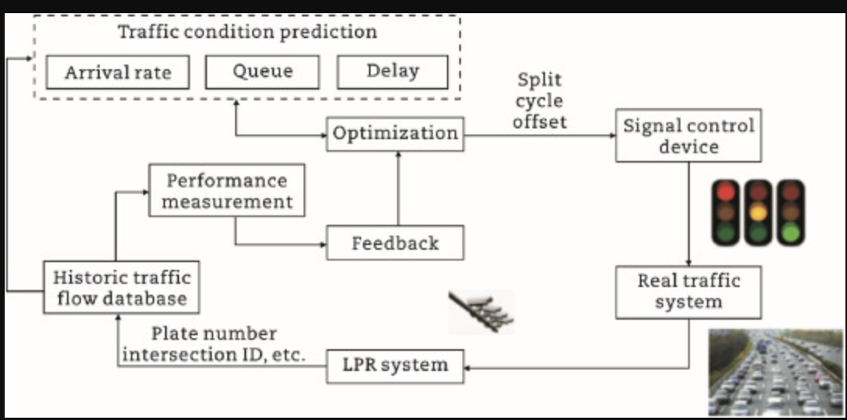

SCOOT — System Architecture
SCOOT operates through a six-layer hierarchical architecture, from field-level detectors up to centralized UTC server control, with a continuous feedback loop feeding updated traffic data back into the model.
ASTRID stores historical traffic data for fallback. INGRID detects incidents by comparing live vs. historical patterns — both are key SCOOT subsystems.

Slide 9
SCOOT — Limitations & Shortcomings
Despite widespread deployment, SCOOT carries significant infrastructure, cost, and architectural constraints that limit its applicability in resource-constrained or rapidly growing urban environments.
Expensive Road Infrastructure
Centralized Single Point of Failure
Complex Setup & Specialist Dependency
Requires inductive loop detectors embedded in road pavement — installation demands road excavation, making deployment and maintenance both costly and disruptive.
All optimization runs on a central UTC server. A server or communication failure reverts the entire network to fixed-time operation, losing all adaptive benefits instantly.
Requires extensive calibration, precisely placed detectors, and specialist engineers for configuration and maintenance — resulting in long setup times and steep learning curves.
No Native Emergency Vehicle Priority
Poor Performance in Low-Volume Scenarios
SCOOT has no built-in mechanism to detect or prioritize emergency vehicles. Extensions exist but require additional hardware and significant integration effort.
In areas with predictable or light traffic, fixed-time plans already perform near-optimally. The overhead of SCOOT's adaptive system adds little value while increasing operational complexity.

Slide 10

Existing System 2 — SCATS Overview
ROADS & TRAFFIC AUTHORITY, NSW AUSTRALIA · LATE 1970S · 170+ CITIES, 20+ COUNTRIES
SCATS (Sydney Coordinated Adaptive Traffic System) is a heuristic feedback-based system that selects optimal signal timing plans from a pre-calculated library based on real-time measurements — rather than computing new timings from scratch like SCOOT.
Core Measurement Parameters
Three-Tier Hierarchical Architecture
Degree of Saturation (DS): Measures how close a lane is to maximum capacity — ratio of green time used to green time available per phase.
Link Flow (LF): Volume of vehicles passing through a link per cycle; used for offset adjustments in inter-intersection coordination.
Tier 1 — Central SCATS Computer: Top-level management; stores the timing plan library and coordinates the entire network
Tier 2 — Regional Computers: Groups of 4–8 intersections; handle local coordination and plan selection for their subsystem
Tier 3 — Local Signal Controllers: Individual intersection units; execute selected timing plans and collect detector data for feedback
Key distinction: SCATS selects from pre-built plans. SCOOT computes new timings continuously. Both rely on centralized infrastructure — a gap our proposed system directly addresses.

Slide 11
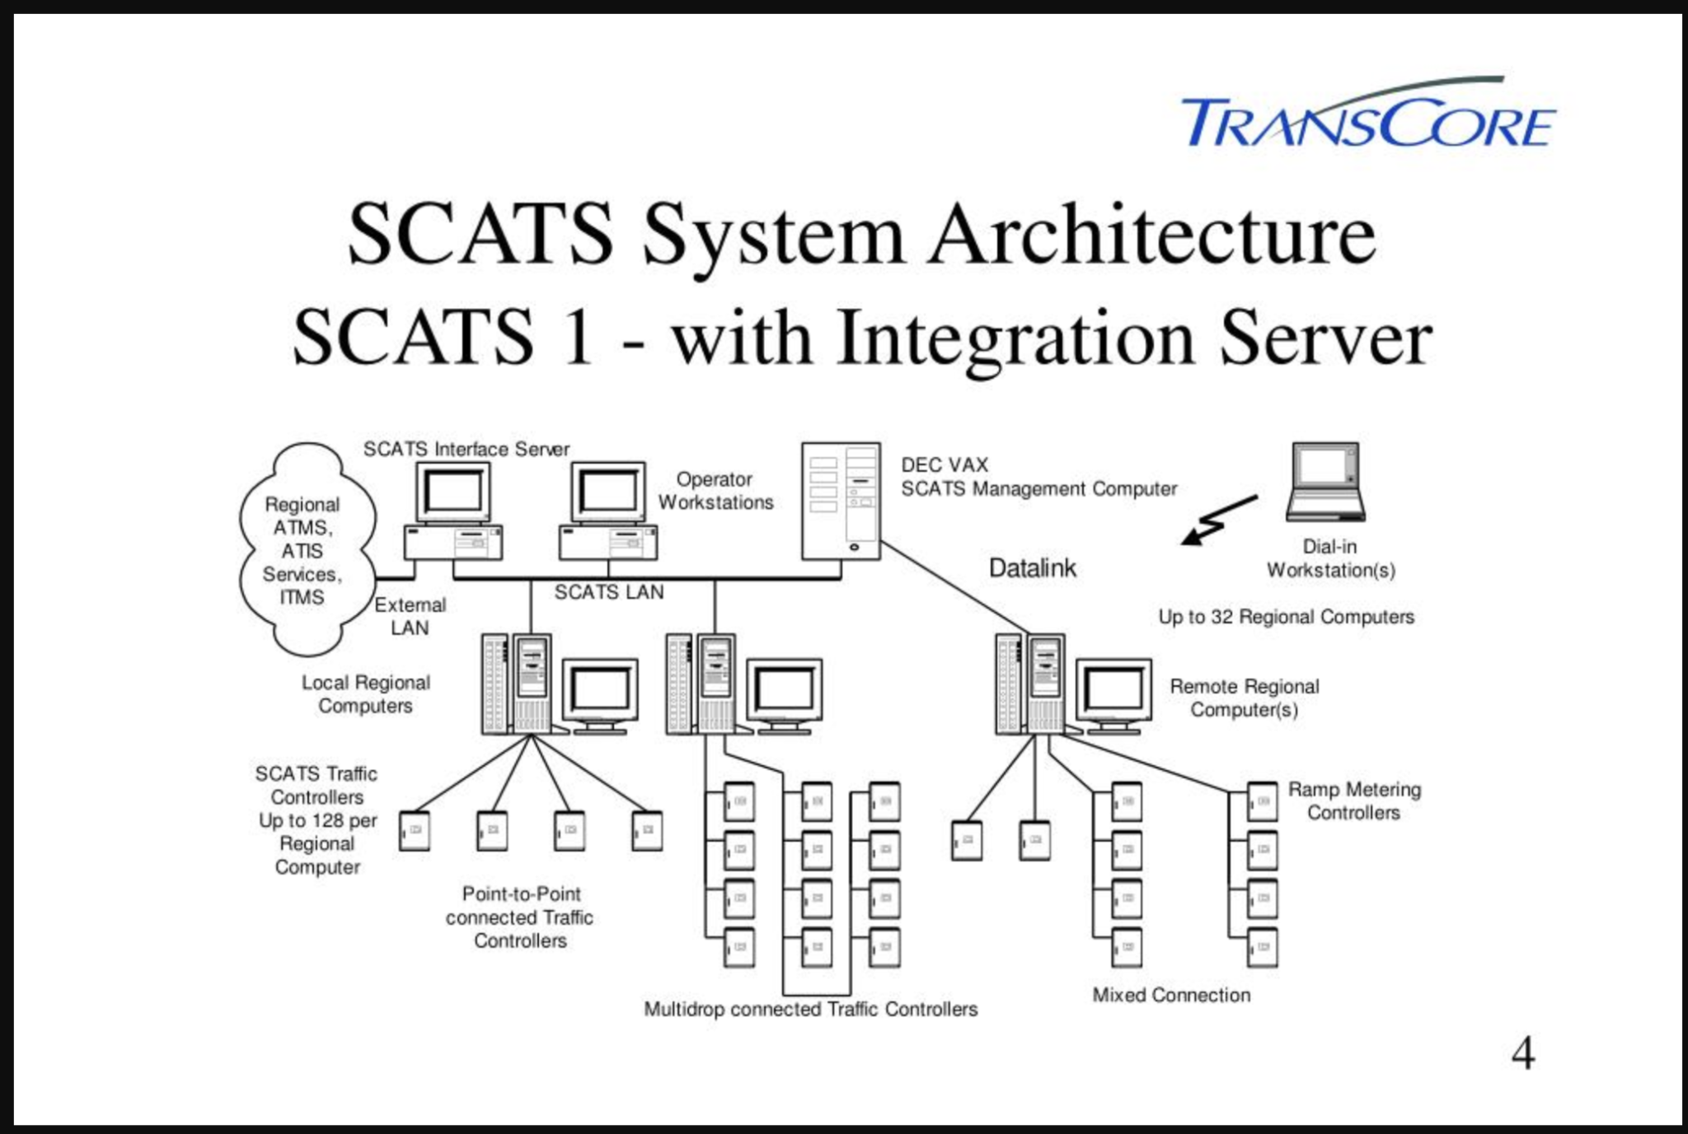
SLIDE 11
SCATS System Architecture

Slide 12
SLIDE 12
Limitations and Shortcomings of SCATS
Despite widespread global deployment, SCATS carries several critical structural limitations that reduce its effectiveness and accessibility, particularly for developing-city environments.
Pre-Calculated Plan Library
Loop Detector Dependency
SCATS cannot generate new signal timing solutions. It only selects from a pre-calculated library. If real-world conditions fall outside covered scenarios, performance degrades significantly — true real-time optimization is impossible.
The entire system relies on inductive loop detectors embedded in road pavement. Faults directly degrade timing quality. Detectors are expensive to install and repair, and failures are common due to road wear and heavy vehicles.
High Infrastructure Cost
Communication Latency
Inductive loops at every approach lane, a three-tier communication network, and specialist-level calibration make SCATS unsuitable for low-budget or developing-city deployments.
Decisions pass through three layers (local → regional → central → back down). In rapidly changing traffic, this lag means the system is always reacting to slightly stale data.
Manual Library Updates
No Emergency Preemption
As traffic patterns evolve seasonally, the plan library becomes outdated. Engineers must periodically re-survey, recalculate, and update the library — requiring continuous specialist labor.
SCATS has no built-in emergency vehicle detection or signal preemption. Priority requires a separate add-on system integrated with dispatch centers, adding complexity and cost.

Slide 13
SLIDE 13
System Comparison: SCOOT vs. SCATS vs. Proposed
The table below directly compares the three systems across eleven key evaluation dimensions, highlighting where the proposed heuristic system offers a clear engineering advantage.
Feature
SCOOT
SCATS
Proposed Heuristic
Control Type
Mathematical model optimization
Heuristic plan selection from library
Real-time rule-based logic
Adaptation Method
Continuous small incremental adjustments
Selects best plan from pre-calculated library
Dynamic if-then rules on live density
Detector Type
Upstream inductive loops
Stop-line inductive loops
IR / Ultrasonic (low cost)
Architecture
Centralized UTC + local controllers
3-tier: Central → Regional → Local
Decentralized: embedded per intersection
Infrastructure Cost
Very High
Very High
Very Low
Emergency Priority
No (add-on required)
No (add-on required)
Yes — built-in core rule
Computational Need
High (central server)
High (central + regional)
Very Low (Raspberry Pi / Arduino)
Setup Complexity
Very Complex
Very Complex
Simple
Scalability
Costly
Costly
Easy and low-cost
Real-Time Novelty
Yes (model-dependent)
No (library-limited)
Yes — adapts to any condition
Deployment Fit
Large cities, high budget
Large cities, high budget
Any city, rapid deployment

Slide 14
SLIDE 14
Proposed System: Heuristic Rule-Based Overview
The proposed system replaces costly infrastructure with an intelligent, lightweight rule engine — observe live vehicle density, apply if-then heuristics, and dynamically allocate green time to the highest-priority lane.
Design Philosophy
Core Heuristic Rules
Emergency Priority
Lightweight
Decentralized
IF emergency vehicle detected → immediately grant green, override all phases
Runs on Raspberry Pi 4 + Arduino Mega — no server hardware required
Each intersection operates fully independently with no central dependency
High Density First
IF Lane A density > Lane B AND above threshold → extend green for Lane A
Real-Time
Transparent
Sensor readings processed every signal cycle (30–120 seconds)
All decision rules are human-readable Python if-then logic
Minimum Green Guarantee
IF any lane waiting > max_wait_time → force minimum green to prevent starvation
Low Traffic Efficiency
IF all lanes below minimum threshold → run shortest cycle to reduce idle time
Balance Waiting
IF two lanes have similar density → alternate with equal green to prevent starvation

Slide 15


Proposed System & Architecture
A real-time, sensor-driven heuristic engine replaces static timing with intelligent, rule-based adaptive control — all on low-cost embedded hardware.
🚦 Real-Time Sensor Input
Vehicle density sensors feed live occupancy data per lane continuously.
🧠 Heuristic Decision Engine
If-then conditional rules select the optimal green phase based on density thresholds.
🚨 Priority Management
Emergency, transit, and high-occupancy lanes are weighted and served with pre-emption logic.
📊 Central Dashboard
Supervisor monitoring interface provides real-time status, alerts, and override capability.

Slide 16
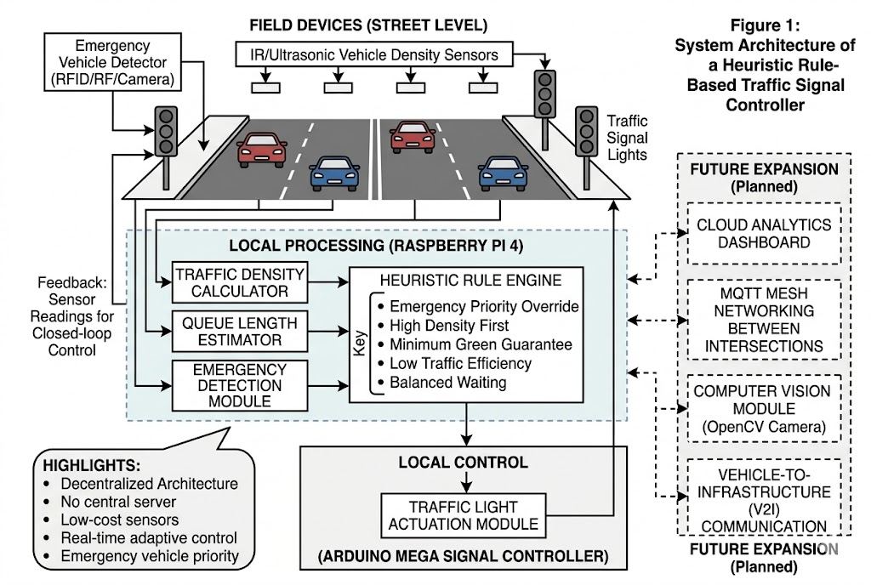

Slide 17

Proposed System — Data Flow
Vehicle Density Sensors
Real-Time Aggregator
Heuristic Decision Engine
Dynamic Signal Controller
Unlike the existing system, the proposed architecture maintains a continuous feedback loop — sensor readings are processed after every signal cycle, enabling the heuristic engine to refine timing decisions dynamically and respond to sudden congestion spikes or emergency events in real time.

Slide 18

Projected Performance Gains
Simulation results from SUMO-based testing demonstrate significant improvements over fixed-cycle baselines across all key traffic metrics.
30%
25%
40%
Reduced Wait Time
Less Congestion
Improved Throughput
Average intersection wait time cut by nearly a third during peak hours.
Network-wide congestion index drops due to dynamic phase balancing.
Vehicles cleared per cycle improves substantially with adaptive green extension.
All results based on SUMO simulation benchmarks comparing heuristic adaptive control vs. fixed-cycle baseline under equivalent traffic load conditions.

Slide 19

SLIDE 19–20
Conclusion & References
Summary
References
This project presents a cost-effective, lightweight, and practical approach to urban traffic congestion through heuristic rule-based signal optimization. By analyzing SCOOT and SCATS, their critical limitations were identified — high cost, centralized architecture, and absent emergency priority — and each was directly addressed.
[1] Robertson, D.I. (1979). "SCOOT — A Traffic Responsive Method of Coordinating Signals." TRRL Lab Report 1014, UK.
[2] Lowrie, P.R. (1982). "SCATS — Sydney Co-ordinated Adaptive Traffic System." Roads and Traffic Authority of NSW, Australia.
Low-cost IR/ultrasonic sensors replace expensive inductive loops
[3] Wikipedia. "Split Cycle Offset Optimisation Technique (SCOOT)." en.wikipedia.org
Raspberry Pi + Arduino replaces central servers
Built-in emergency priority as a core heuristic rule
[4] Wikipedia. "Sydney Coordinated Adaptive Traffic System (SCATS)." en.wikipedia.org
Decentralized — each intersection fully independent
[5] McCann, B. "A Review of SCATS Operation and Deployment in Dublin." JCT Consultancy, 2014.
Validated through SUMO simulation before hardware deployment
Designed for tier-2 and tier-3 Indian cities — making adaptive signal control accessible and affordable where it is needed most.
[6] SUMO Documentation. "Simulation of Urban MObility." sumo.dlr.de/docs/
[7] FHWA. "Adaptive Signal Control Technology (ASCT)." US DOT, 2017.
Future Scope
IoT cloud integration (AWS IoT / Google Cloud IoT) for city-wide deployment
Computer vision via USB camera + OpenCV for vehicle counting and type classification
Multi-intersection coordination using MQTT mesh networking
Weather and time-of-day factors added to the heuristic rule set
Research paper publication based on SUMO simulation results
[8] Stevanovic & Martin (2008). "SCOOT and Coordinated Actuated Control via Microsimulation." Transportation Research Record.
[9] Raspberry Pi Foundation. "Raspberry Pi 4 Model B Documentation." raspberrypi.com
[10] Arduino. "Arduino Mega 2560 Reference." docs.arduino.cc

Slide 20


